Slide 1
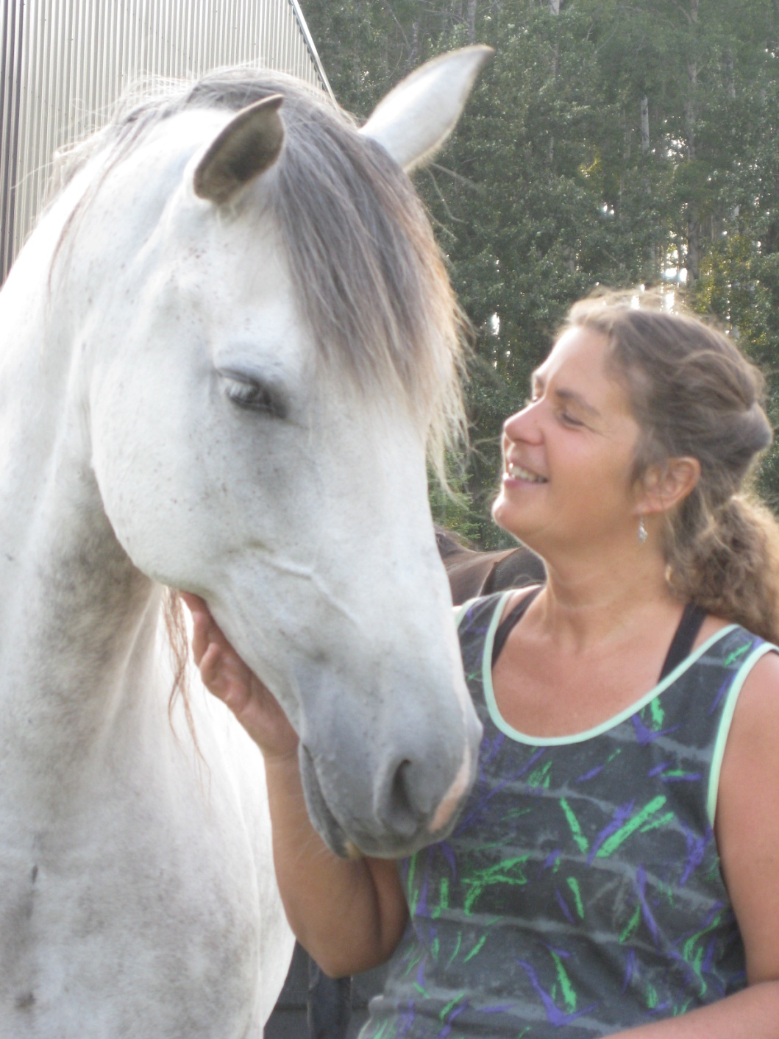
Turn Around
Ranch
TURNING LIVES AROUND
Equine Assisted Counseling and Traditional Counseling in a relaxed, informal setting.
For kids, teens, adults,
families and groups.

Slide 2
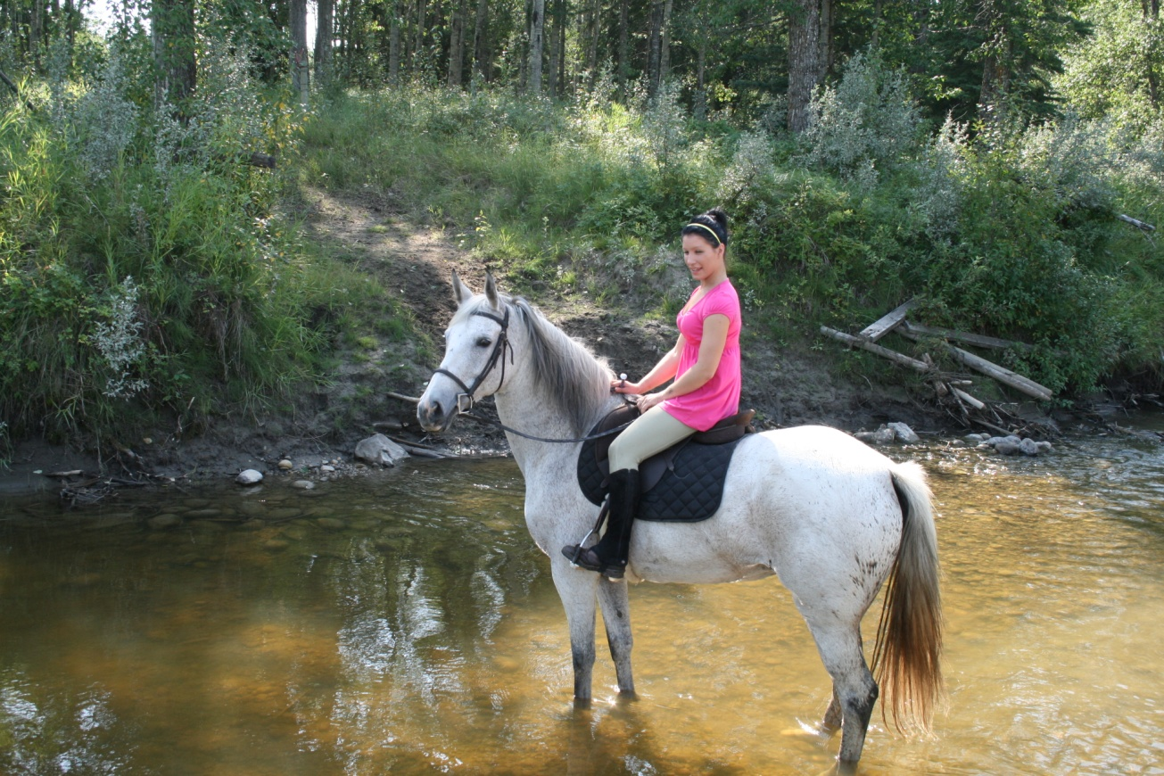
The Turn Around Ranch is set in a 1000 acres of forested hills. A creek runs throughout the property and the ranch is bordered by the North Saskatchewan River.
The ranch is located 15 minutes NW of Rocky Mountain House

Slide 3
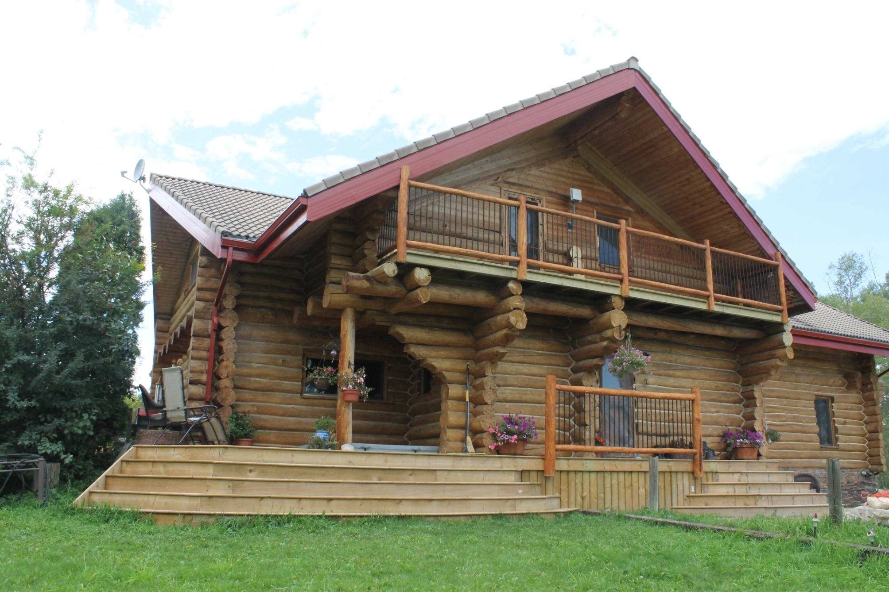
The Hilltop Haven is over 7,500 square feet and is a lovely place to settle into as clients are
turning things around inside.

Slide 4
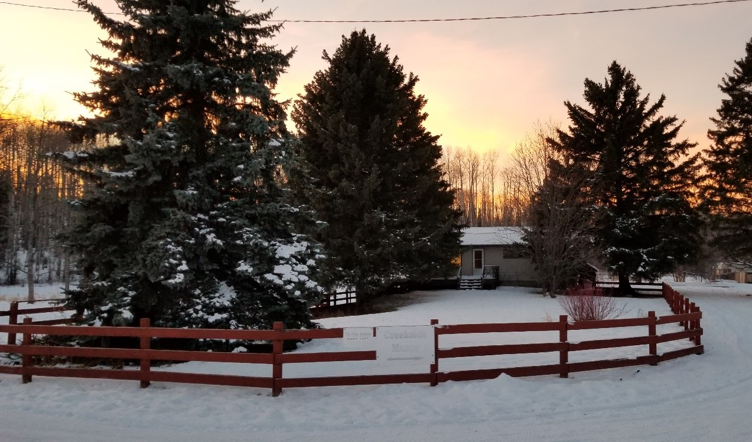
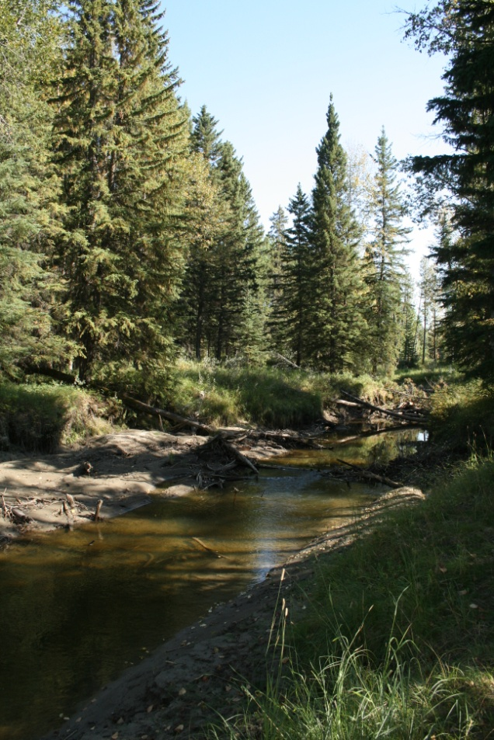
The Creekside Manor is our residential treatment group home that is licensed for six clients.
It is nestled into the bends of Buster Creek
and has a big vegetable garden out back.

Slide 5
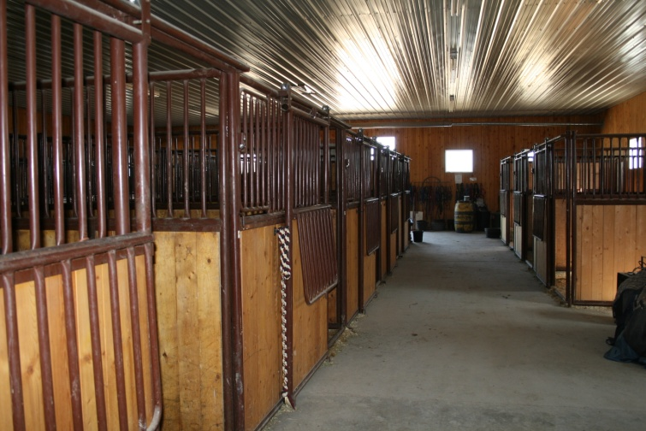
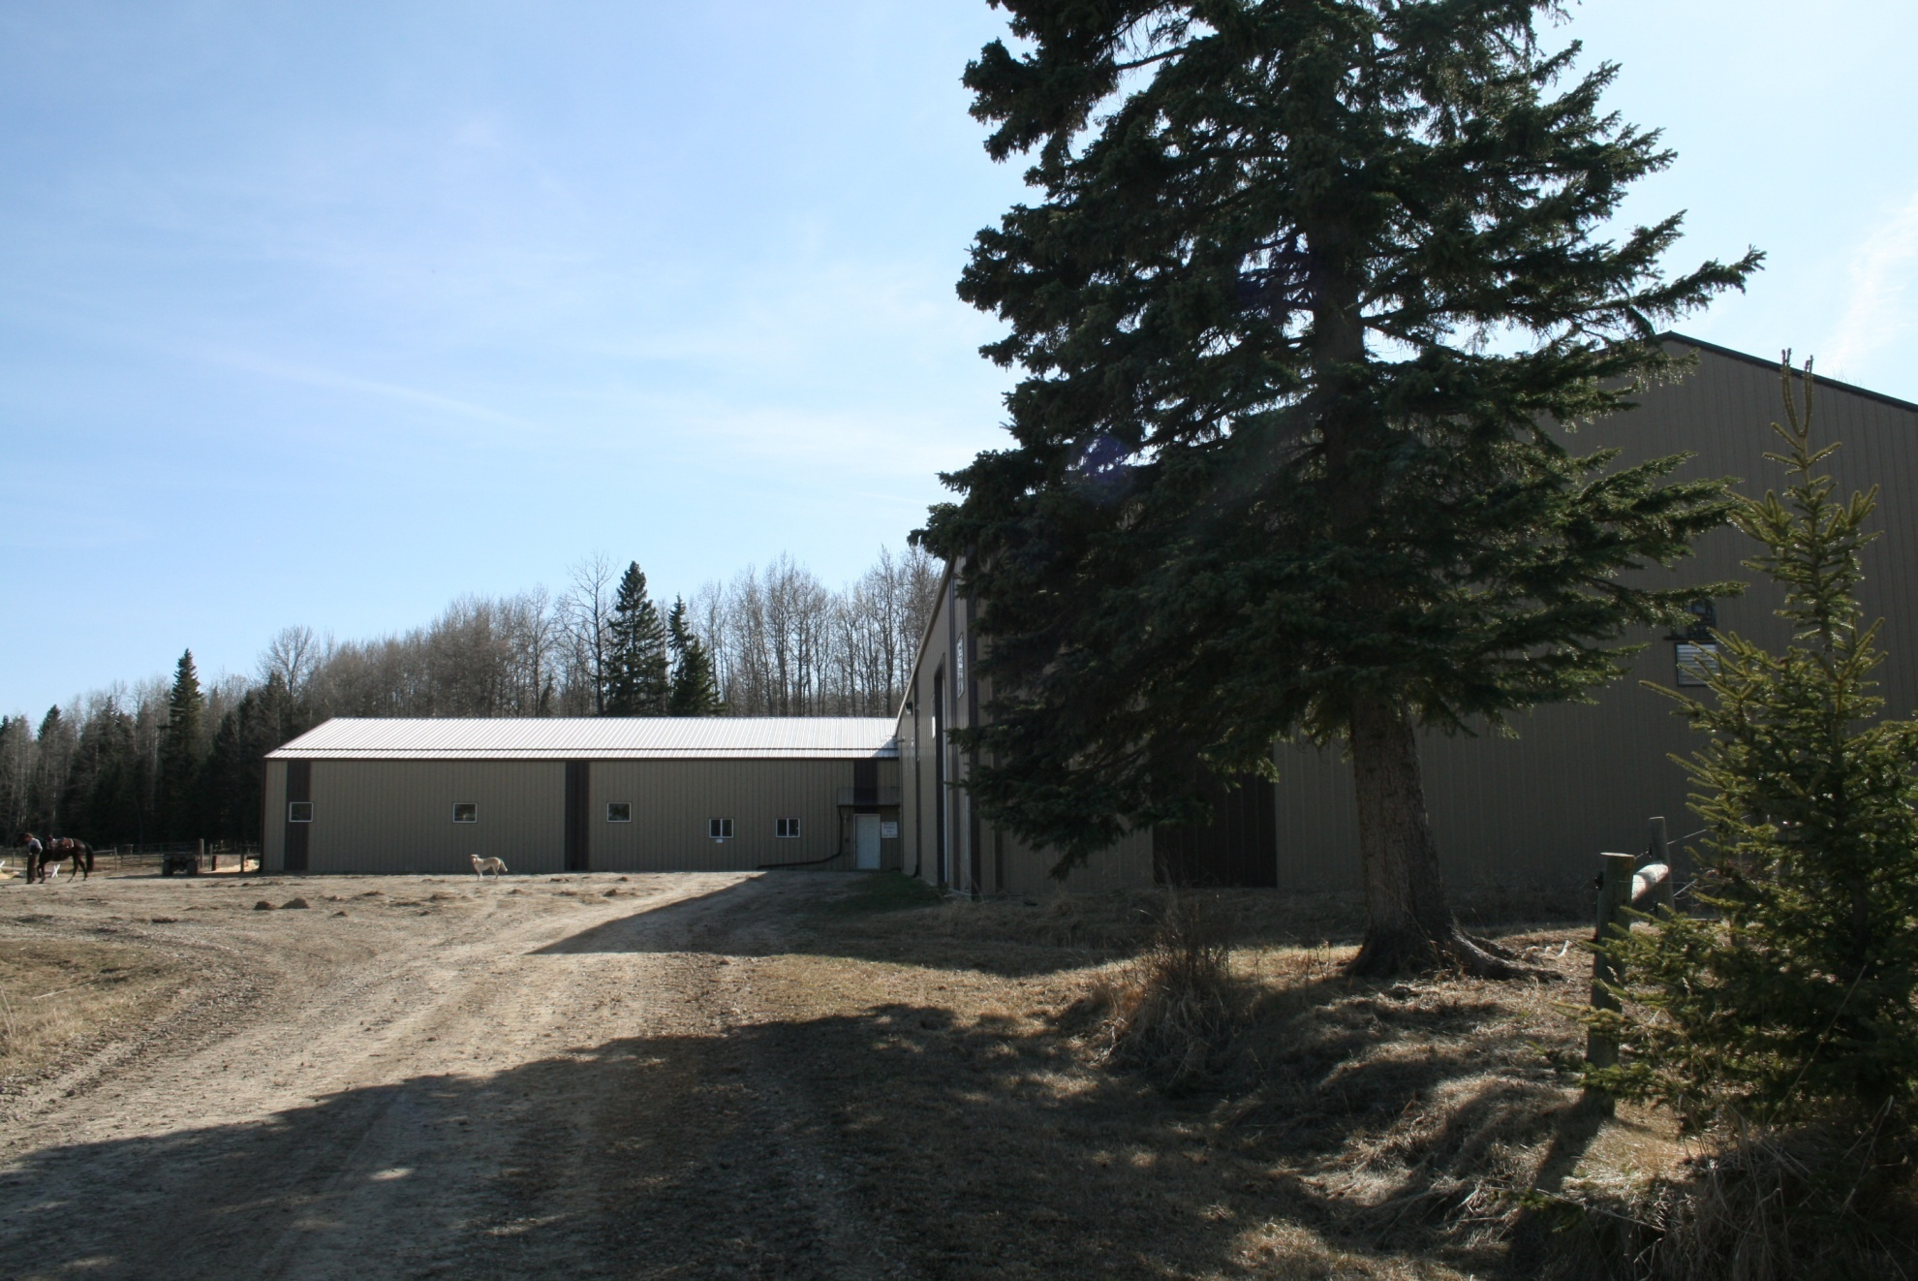
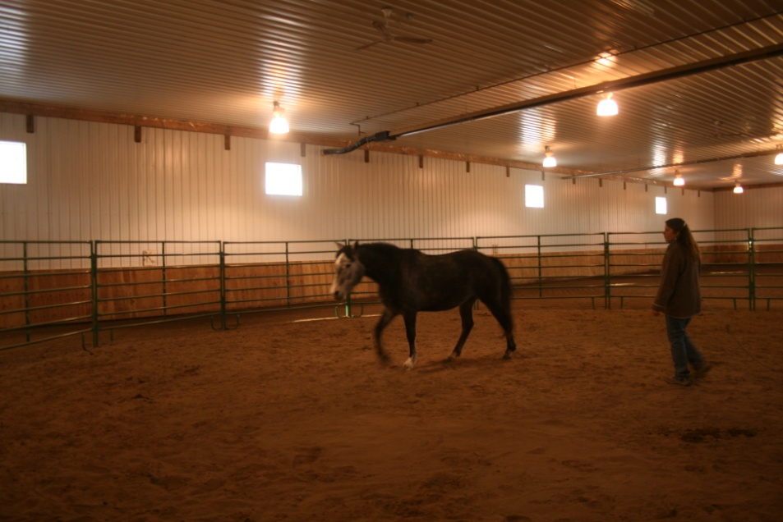
The ranch boasts a 13 stall stables
and adjoining 70’x170’ heated arena
Equine assisted counseling and workshops happen all year round.

Slide 6
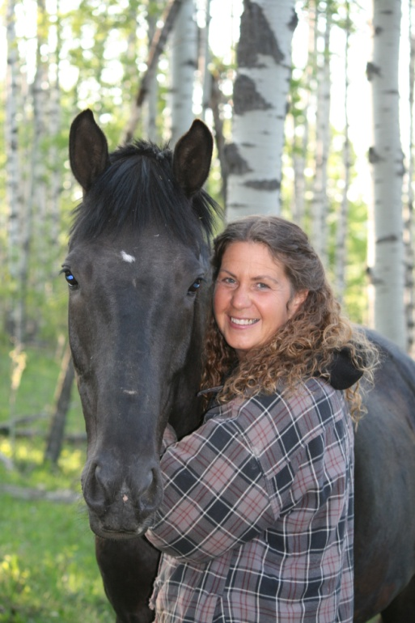
WENDY TREDGER
BA in Psychology
Master’s degree in Counseling
Canadian Certified Counselor
23 YEARS EXPERIENCE
AS A COUNSELOR WITH CHALLENGED YOUTH
Completed Level I & II
Equine Assisted Counseling
43 years of working with horses

Slide 7
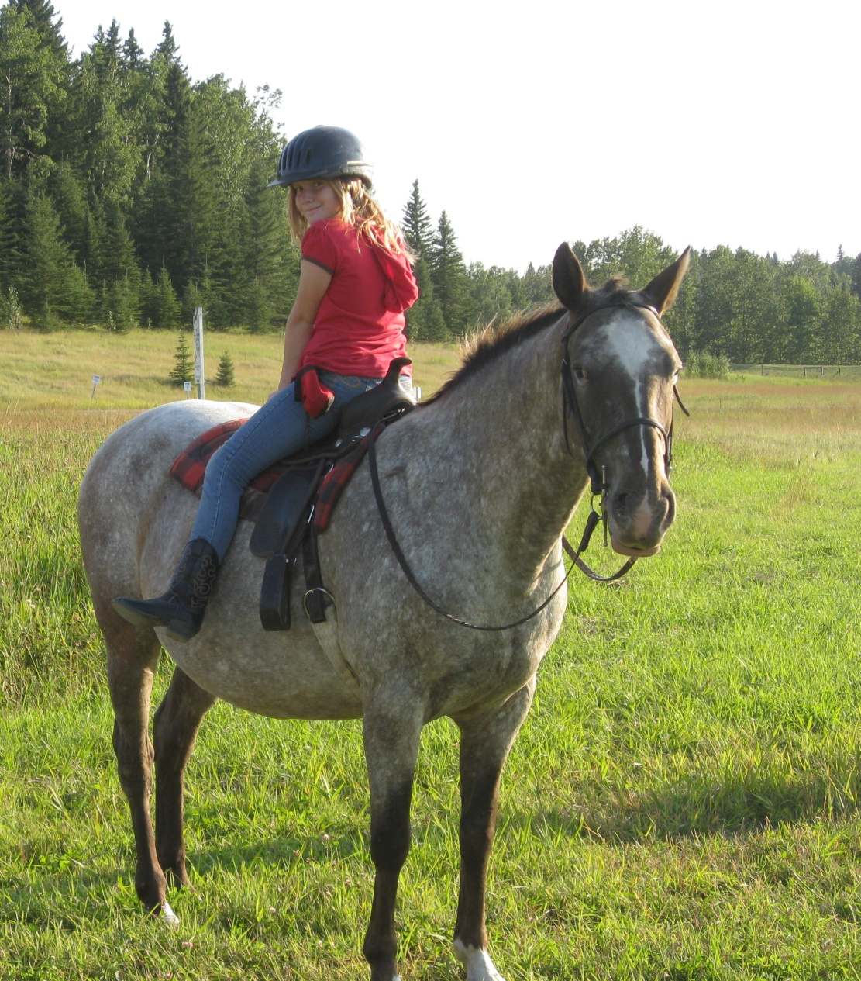
Sometimes we all feel like our lives have been turned upside and backwards. . .
and processing with someone who cares,
gaining some new wisdom and coping strategies can help!
We are all about turning lives around!

Slide 8
Sometimes it takes a giant leap in a new direction.
Equine Assisted Counseling
is a very dynamic form of experiential therapy.
Interactive sessions with the horse and counselor supplement the traditional office context of just talking and listening that usually go on in counseling.
Clients learn by doing, not just by talking about things.
No prior experience with horses is needed and riding is not what it is all about – 90% of what goes on in equine assisted counseling happens on the ground.

Slide 9
Why use horses as co-counselors?
This counseling is based on both insight and experiential application.
It often obtains better, more lasting results in a shorter time than with only talk therapy.
Horses are very good
at unconditional love and provide breakthroughs
with clients who are reluctant to trust
other humans.
It’s more fun, relaxed, informal and
less intimidating than an office counseling experience.

Slide 10
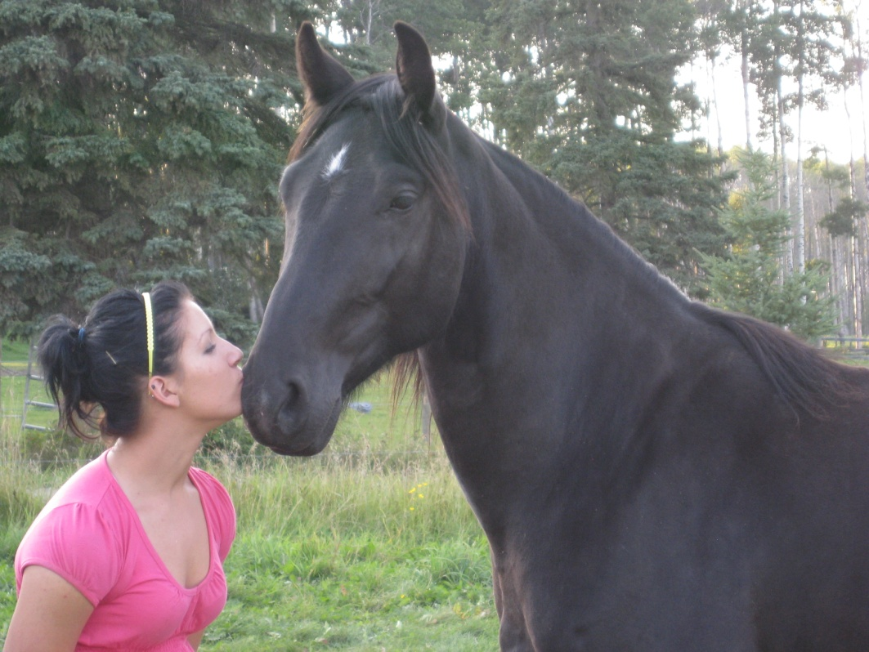
Why use horses as co-counselors?
Connection with horses provides powerful metaphors and experiential learning opportunities as clients work through their issues.
Horses are profoundly tuned into what is happening inside people and are well able to give feedback that is valuable.
Working with horses engages most of the senses: sight, touch, sound and smell. It also engages different learning styles.

Slide 11
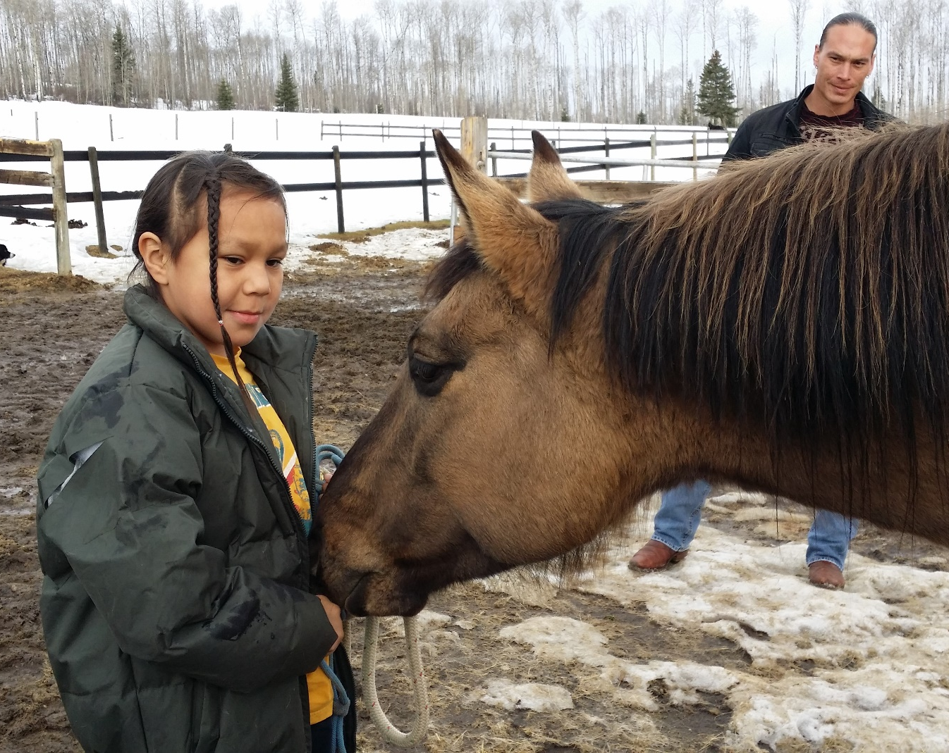
Why use horses as co-counselors?
Why use horses as co-counselors?
When working with aboriginal clients,
it helps for us to be aware that horses
have been a
significant part of
many aboriginal lives
and cultures for thousands of years –
the original
“horse whisperers.”
Many who have been through abuse are reluctant to allow themselves to trust in relationship with humans, but will find this trust with an animal.

Slide 12
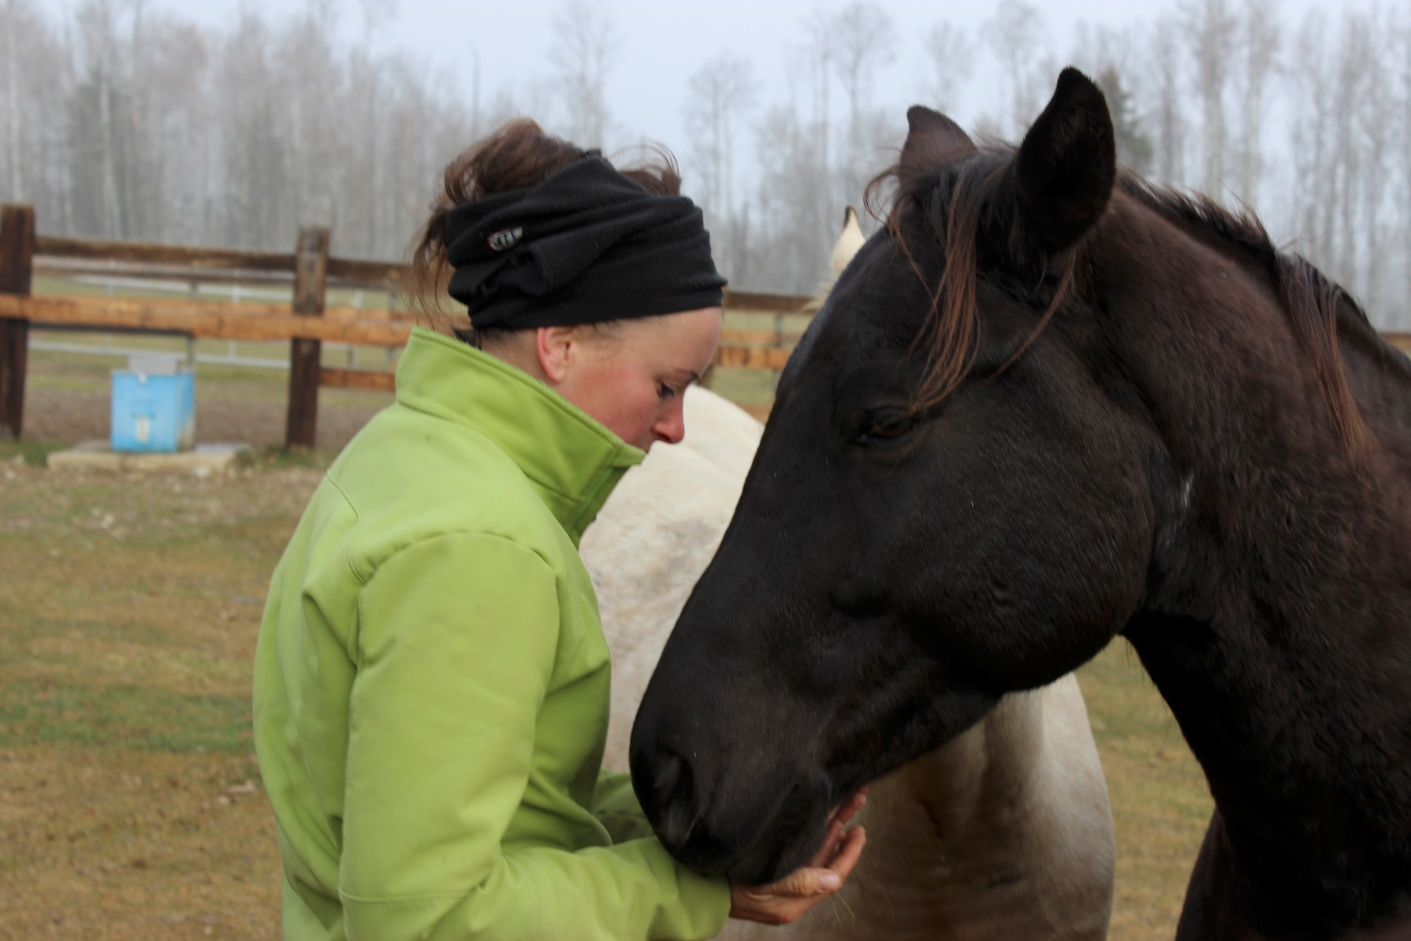
Why use horses as co-counselors?
Many horses are innate experts in PTSD issues as they live with a
constant state of hypervigilance as a survival instinct.
Horses help clients tune into body awareness when they have disassociated to survive abuse and trauma.

Slide 13
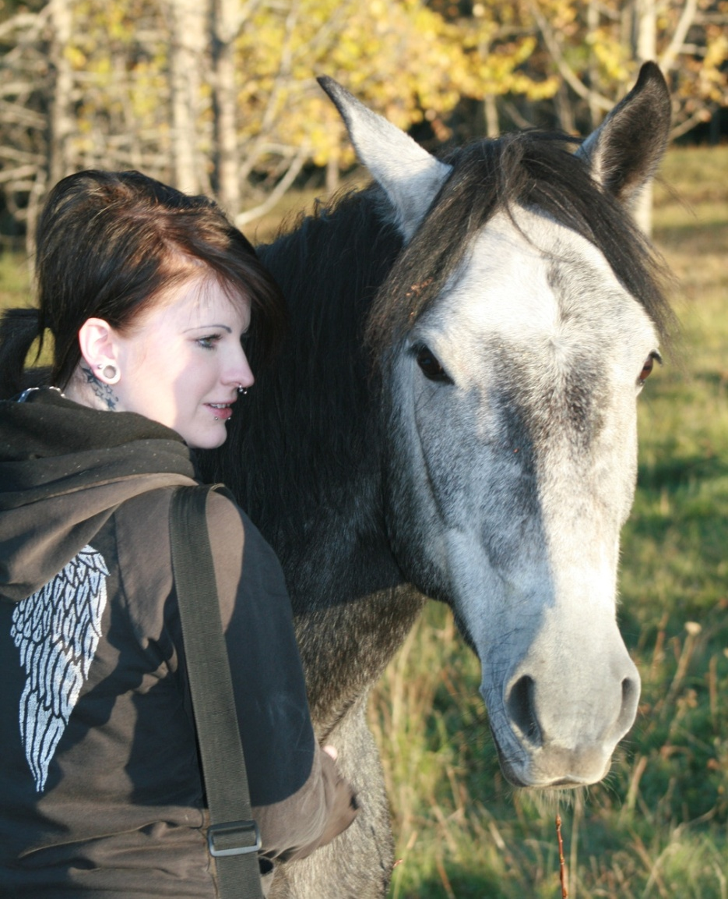
HORSES AND COUNSELORS CAN HELP:
Behavioral issues
Abuse issues
Anxiety
Communication skills
Relationship issues
Parenting challenges
Addiction issues
Depression
Anger management
Couples challenges
Eating disorders
Self esteem enhancement
Thought disorders
Personal development & growth

Slide 14
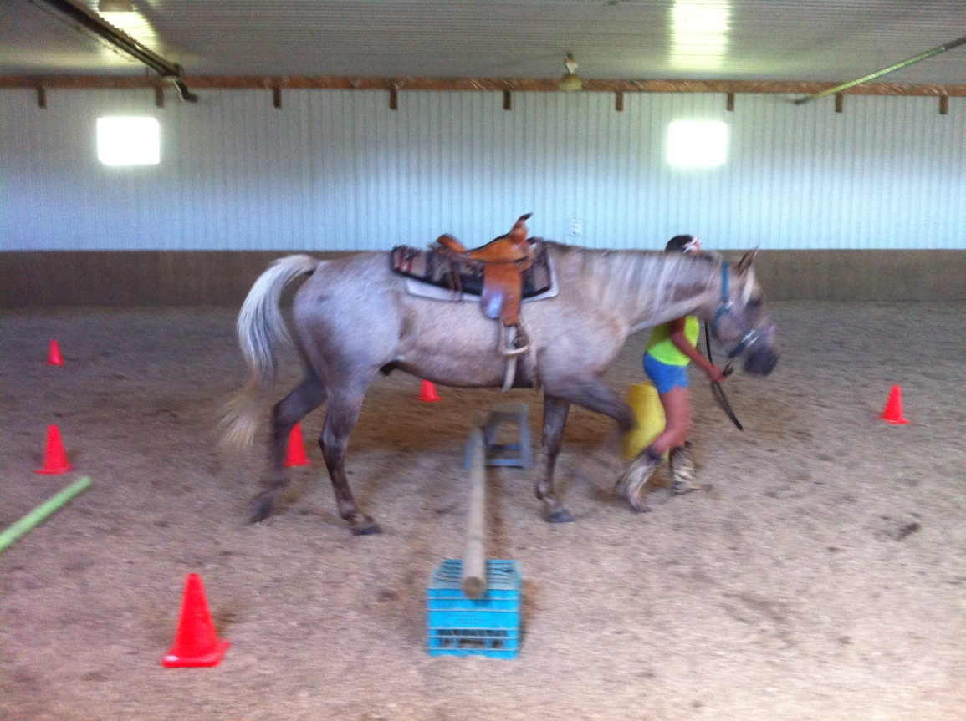
POTENTIAL GAINS FROM THIS EXPERIENCE:
Assertiveness
Teamwork
Self awareness
Problem solving
Responsibility
Creative thinking
Confidence / self esteem
Leadership skills
Non-verbal communication skills
Horsemanship skills
“A breath of fresh air”
as you deal with your issues, obtaining new perspectives on old problems!

Slide 15
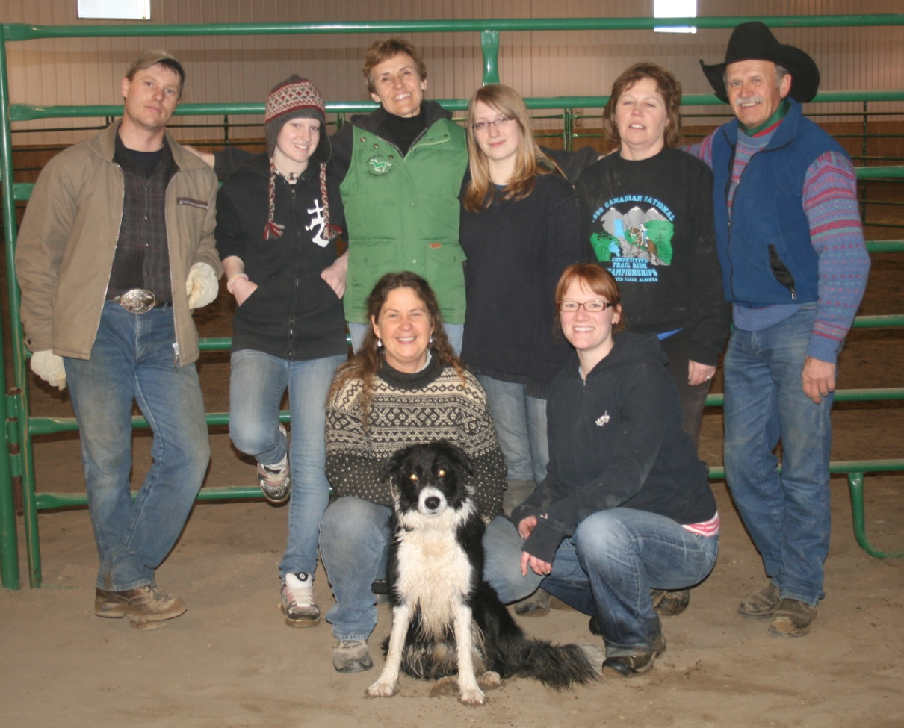
The Turn Around Ranch does both traditional counseling and Equine Assisted Counseling in a number of modalities.
Hourly counseling sessions
Family sessions
Small group sessions
Treatment group home for 6 clients.

Slide 16
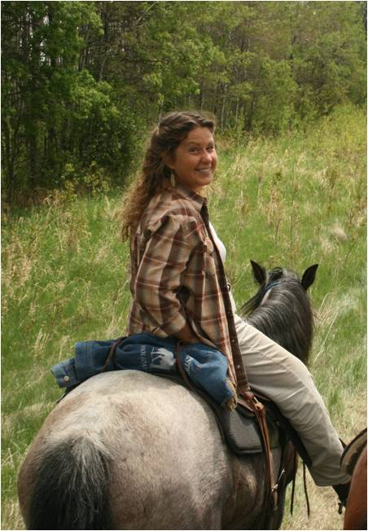
TURN AROUND RANCH
Turning lives around through
a counseling partnership
with horses
in a serene outdoor setting
to create lasting change
in the lives of
those we serve.

Slide 17
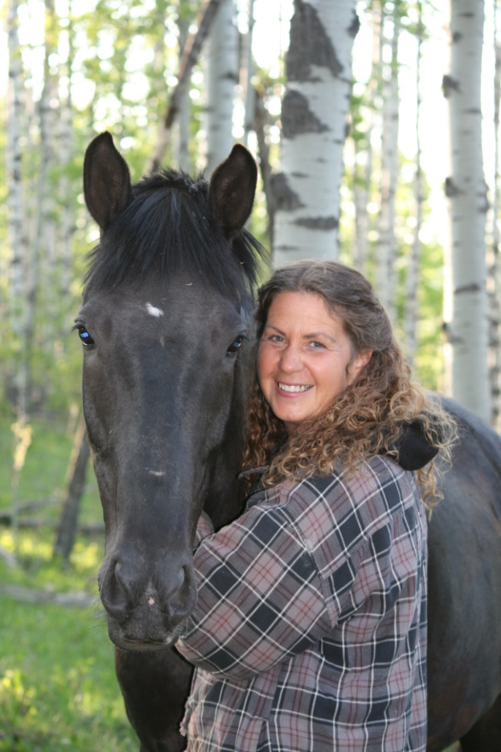
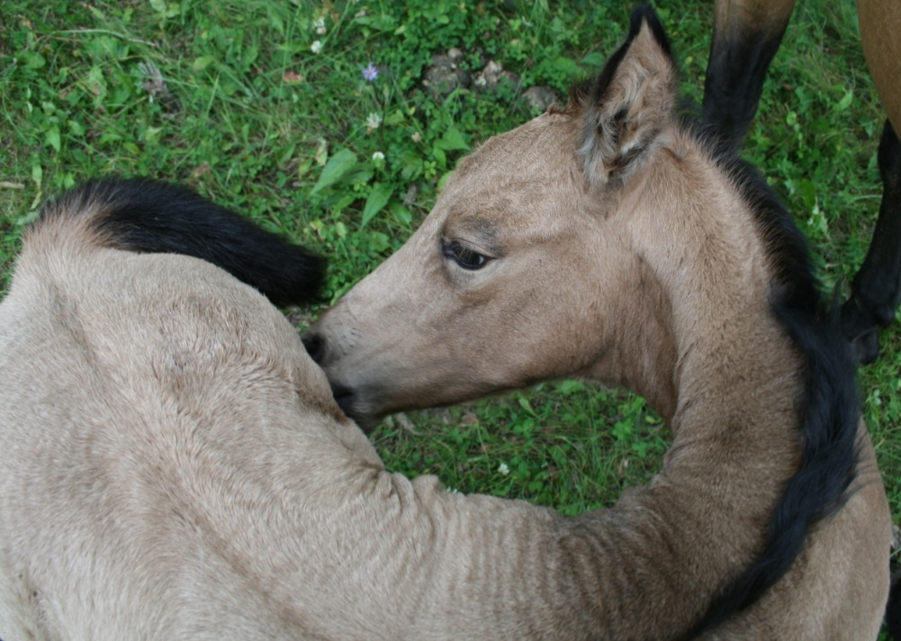
Turn Around
Ranch
Located 15 minutes NW of Rocky Mountain House
Box 699
Rocky Mountain House, Alberta
T4T 1A5
Website: turnaroundranch.net
Email: turnaroundranch@live.ca
(403) 895-6995 cell
(403) 845-6996 ranch
(403) 845-6993 group home

